Slide 1
BIG DATA TOOLS
MODULE 2
WEEK 2

Slide 2
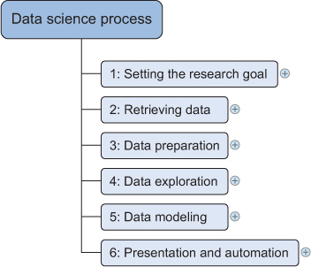
Last week
Types of Big Data
Structured
Unstructured
Natural language
Machine-generated
Graph-based
Audio, video, and images
Streaming

Slide 3

Learning Objectives
Introduction to Hadoop file system and it’s common commands
Introduction to HIVE
Hcatalog functionalities
Hortonworks sandbox
using Hadoop in sandbox to get and put file data.

Slide 4
Handling large data
A large volume of data poses new challenges
Not enough memory
Never ending processes
Not enough speed to catch up with the data flow
Hardware bottleneck (I/O, CPU, …)
Solution
Using the right tools
Using the correct algorithms,
Choosing the right data structure

Slide 5
Challenge: design a system to deal with big data
You have a set of machines in a network
You should store/load a large set of any data
Be fault tolerant
Extract or transform the required part of data
Aggregate the result across machines
Acceptable data process time
Store the end result

Slide 6
Database Choices
File systems
Cloud
HDFS (Hadoop Distributed File system)
Google file system (GFS)
Databases
NoSQL (key-value, column store, document, graph,…)
Relational databases

Slide 7
Distributing data storage and processing
Apache Hadoop is a framework that simplifies working with a cluster of computers in terms of:
Reliable —automatically creating multiple copies of the data.
Fault tolerant —It detects faults and applies automatic recovery.
Scalable —Data and its processing are distributed over clusters of computers (horizontal scaling).
Portable —Installable on all kinds of hardware and operating systems.
It Brings the code to data rather than data to code

Slide 8
Hadoop versus Relational Database
 | Relational database | Hadoop
Schema | Required on write | Required on read
Speed | Fast on read | Fast on write
Governance | Structured data | Any data
Processing | Limited | Coupled with data
Scalability | Scale up | Scale out
Best use | OLAP, ACID, Operational | Massive Data discovery/processing
HDFS has demonstrated production scalability of up to 200 PB of storage and a single cluster of 4500 servers, supporting close to a billion les and blocks.
OLAP is an acronym for Online Analytical Processing
ACID (Atomicity, Consistency, Isolation, Durability)
Notes:
Explain Schema
Explain how Hadoop in the context of enterprise data warehouse

Slide 9
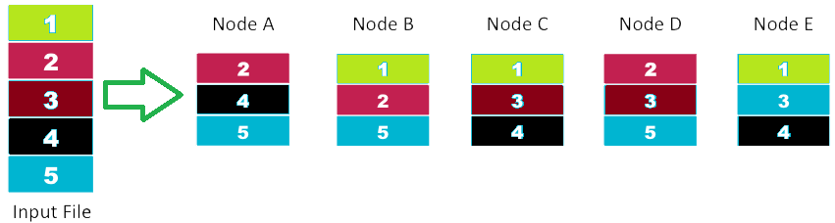
HDFS
Hadoop distributed File system (HDFS)
It acts as an ordinary file system
Storing and dealing with Fault tolerance
The system is self healing
Smaller number of large files rather than bigger number of small files
Files are typically not updated
No random acess
Default replication: 3

Slide 10
Hadoop programming
No update in place; the results are stored in a new file
You have different options in terms Full control and productivity
Data engineer background
Java as a native language for dealing with Hadoop
Using Hadoop streaming you can use other languages than Java to leverage the Hadoop capabilities (e.g. Python)
Hive (an SQL-like language), more productivity than Java
PIG (a data flow language)

Slide 11
Installing Hadoop
Runs on Linux/Unix operating system but not recommended on windows.
3 modes for installation:
Stand-alone (default)
Pseudo-Distributed
Fully Distributed.

Slide 12
Stand-alone installation mode
Simplest mode
Runs on a single node (machine)
Get the Java jar file and run it on a single JVM process
It uses the local file system for storage and HDFS does not run at all.
YARN does not run as well; no negotiation for resources; no master slave in cluster.
It is good for testing purposes (testing mapReduce).

Slide 13
Pseudo-Distributed
To simulate an actual cluster.
Run in a single node
2 JVM processes is used to simulate 2 nodes (master and slave)
HDFS for storage
YARN to manage resources.
Used as fully-fledged test environment

Slide 14
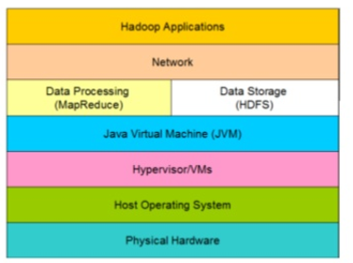
Java virtual machine (JVM)
A Java virtual machine (JVM) is an abstract computing machine that enables a computer to run a Java program.
JVMs do not share state
➔ Map-Reduce

Slide 15
Fully Distributed
Production version
Runs on a cluster of machines with real distributed setup
Run on a physical data center or run on the cloud.
None trivial operation to install and parameter configuration
Using enterprise edition of Hadoop
CDH- Cloudera Distribution for Hadoop (first commercial distribution)
MapR- M series (M3, M5, M7)
HDP- Hortonworks Data Platform

Slide 16
Hadoop Distributions
Open source
Apache Hadoop
Commercial
Cloudera
Hortonworks
MapR
Cloud
AWS edition
Windows Azure HDInsight edition
Any commercial edition or Apache edition

Slide 17
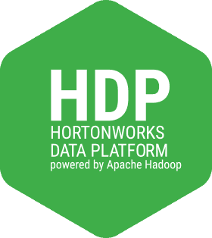
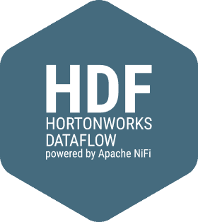
Hortonworks Sandbox
The Sandbox is a pre-configured learning environment that contains the developments from Apache Hadoop Enterprise.
There are two sandboxes available: Hortonworks Data Platform (HDP) and Hortonworks DataFlow (HDF).
HDP (Hortonworks data platform)
single node cluster of Apache Hadoop
Apache Hadoop, Apache Spark, Apache Hive, Apache Hbase,….
HDF (Hortonworks Data Flow)
to make processing data-in-motion an easier task while also directing the data from source to the destination.
NiFi, Storm, Ranger and Ambari UIs
Notes:
Why/When do we use HDP versus HDF?
Explain data in motion.

Slide 18
Hortonworks Sandbox
Hortonworks Sandbox Deployment is available in three isolated environments:
virtual machine
A virtual machine is a software computer that, like a physical computer, runs an operating system and applications. The virtual machine is backed by the physical resources of a host.
Container
Containers are similar to virtual machines except without the hypervisor. Containers are applications, such as HDF or HDP, that run in isolated environments for testing, staging and sometimes production. A container is an instance of an image. Containers run directly on the host machine’s kernel, which results in using less memory resources.
cloud.

Slide 19
SandBox in VM
Install the sandbox
Learn the host address of your environment
Connect to the welcome screen
Multiple ways to execute terminal commands
Send data between sandbox & local machine
https://hortonworks.com/tutorial/learning-the-ropes-of-the-hortonworks-sandbox/

Slide 20
Interacting with HDFS
Using command: hdfs dfs COMMAND
Do it yourself
hdfs dfs –help [COMMAND …]
Hdfs dfs –usage [COMMAND …]
List the file/directory (hdfs dfs -ls)
Make directory (hdfs dfs –mkdir <directory name>)
Get and put

Slide 21

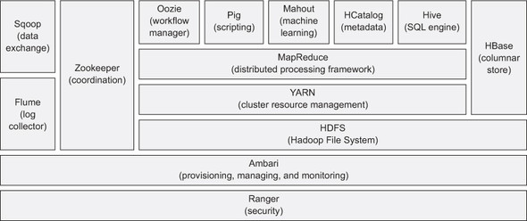
Hadoop Tech Stack
Hadoop Core
HDFS, Yarn, MapReduce
Data integration
SQOOP, Flume, Chukwa, Kafka, HCatalog
Data Serialization
Avro, Thrif
Data Storage (NoSQL)
Hbase, Cassandra
Data Access/Analytics
Pig, Hive, Giraph, Storm, Tez, Spark
Management
Ambari
Data Intelligence
Mahout
Security
Knox, Sentry, Ranger
Hadoop Dev Tools
HDT
Orchestration
Zookeeper, Oozie

Slide 22
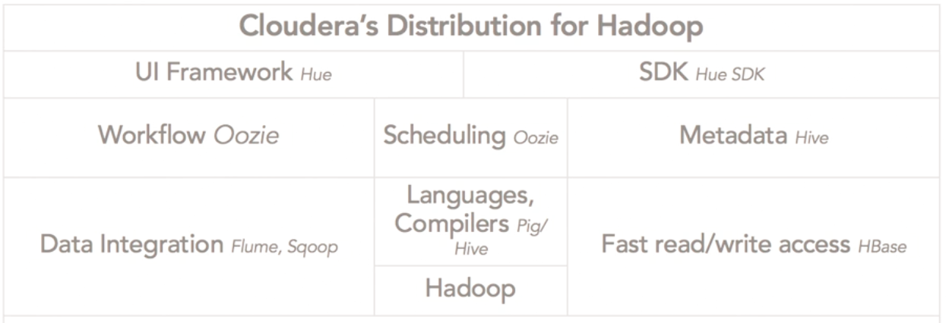
Cloudera Hadoop

Slide 23

Hive
Apache Hive is a data warehouse software project built on top of Apache Hadoop for providing data summarization, query, and analysis. Hive gives an SQL-like interface to query data stored in various databases and file systems that integrate with Hadoop.
Hive has three main functions:
data summarization
data query
Data analysis.
Hive users have a choice of 3 runtimes when executing SQL queries; MapReduce, Tez, or Spark.
https://https://en.wikipedia.org/wiki/Apache_Hive
Notes:
Explain what runtime is.

Slide 24
Apache Hive
Hive on LLAP (Live Long and Process) makes use of persistent query servers with intelligent in-memory caching to avoid Hadoop’s batch-oriented latency .
The tables in Hive are similar to tables in a relational database, and data units are organized in a taxonomy from larger to more granular units.
Hive Cheat Sheet: http://hortonworks.com/blog/hive-cheat-sheet-for-sql-users/
Hive Language Manual: https://cwiki.apache.org/confluence/display/Hive/LanguageManual
Notes:
Explain LLP

Slide 25
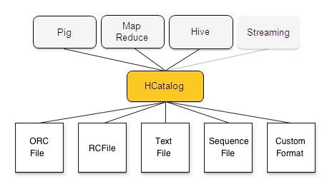
HCatalog
HCatalog is a component of Hive. It holds a set of files paths and metadata about data in a Hadoop cluster.
Enables users to access data as a set of tables without having to worry about how/where data is stored.
This allows scripts, MapReduce and Tez, jobs to be decoupled from data location and metadata like the schema.
https://www.youtube.com/watch?v=_dVlNu4lqpE
Notes:
Explain metadata

Slide 26

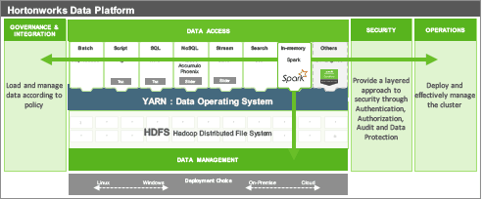
Virtual machine vs Sandbox
Ambari
Browser: IP:4200
ssh/Putty (port :2222)
Virtual machine
Your computer

